Slide 1




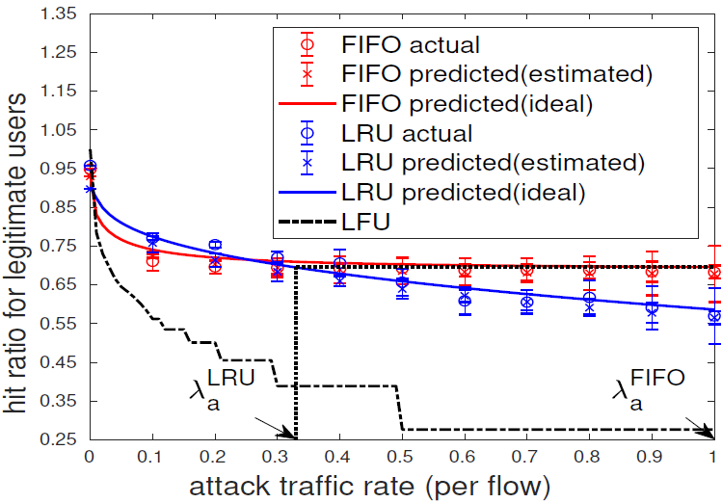

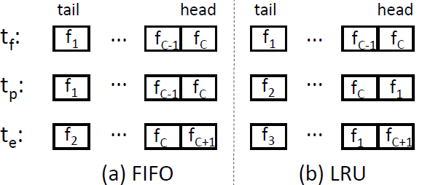

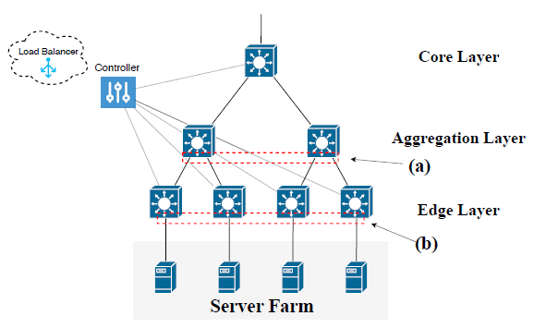
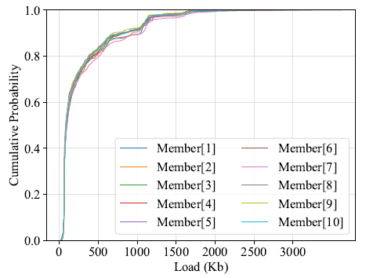

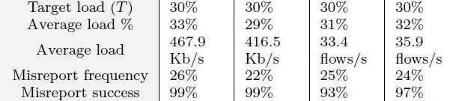
SaTC: CORE: Small: Adversarial Network Reconnaissance in Software Defined Networking
Ting He (PI), Patrick McDaniel (Co-PI)
https://nsrg.cse.psu.edu/research/satc-core-small-adversarial-network-reconnaissance-in-software-defined-networking/
attack target
routing
access control
…
load
balance
Control plane
Thrust 1: Adversarial reconnaissance
Software Defined Network
SDN Controller
Thrust 2: Intelligent attacks
Defenses (future work):
Attack detection
Attack prevention
Attack resilience
Data plane
Task 1A: Host-based reconnaissance
Task 2A: Host-based attack
control agent
Task 1B: Switch-based reconnaissance
Task 2B: Switch-based attack
flow table
CA
CA
CA
CA
attack target
compromised switch
Thrust 3: Evaluation & measurement
compromised host
Challenge:
Data-control plane separation in SDN introduces new attack surfaces
  Data plane relies on commands from a remote controller for operation
  Controller’s decision relies on accurate network state reported by data plane switches
Insufficient understanding of the consequences of such separation in face of intelligent adversaries
Scientific Impact:
Identify new attacks exploiting the vulnerabilities of SDN through adversarial reconnaissance, by answering
  What information can be deduced by an internal/external adversary?
  What is the consequence of exposing this information?
Provide guidelines on future SDN designs with better resilience against intelligent adversaries
Solution:
Adversarial inference of internal characteristics:
Host-based inference & attack on flow table
  use RTTs to detect table hits/misses for probing packets
  infer table size using forward-backward probing
  infer replacement policy by flush-promote-evict probing
Switch-based inference & attack on load balancer
  estimate the load distribution at other pool members based on loads observed at the compromised switch
  under-reporting: attract an unfairly large portion of traffic
  over-reporting: cause unfairly large loads on other members
...
Size Inference
controller
...
Policy Inference
Intelligent DoS Attack
Estimate load distribution
Intelligent Misreport
target portion of traffic
misreporting threshold
misreporting frequency
load balancing pool
Broader Impact on Society:
Raise awareness SDN’s vulnerabilities
Motivate new designs and best practices
Generate lessons learned for SDN administrators and developers
Broader Impact on Education:
Disseminate results to the community
  1 INFOCOM, 1 ICDCS, 1 SecureComm, 3 journals, open-source code
Train new workforce on SDN and security
  2 PhD, 3 MS, including 2 female
Broadening Participation:
CSE summer camp 2021-22: introduce 15-20 middle school girls to cutting-edge topics in CS through week-long interactive programs
Girls Who Code: provide free coding classes on Sundays to local female middle/high school students
N2Women: mentor female PhD students to organize panels at INFOCOM’20 and ICCCN’22
Add Your Logo and/or project info here
Award ID#: 1946022
Notes:
Here’s the GWC info:
Penn State’s Girls Who Code (GWC) is a collaborative program organized by the Association of Women in Computing (AWC) and the School of EECS, focusing on outreach to local middle and high school students. The program functions under the international nonprofit, Girls Who Code, with a broad mission to close the gender gap in technology and engage more youth in computer science. GWC meets on Sundays during the spring semester for nine weeks, with an introductory programming curriculum using Python. Graduate and undergraduate student volunteers from EECS and AWC support GWC as instructors and presenters.
Attendance Average: 18 middle high students a week. Total staff: EECS coordinator (me); 5 grad students; 1 student director; 5 undergrad instructors and 5 undergrad tech talk volunteers.

